Slide 1
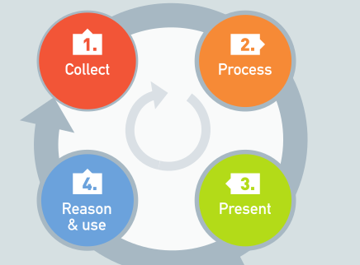
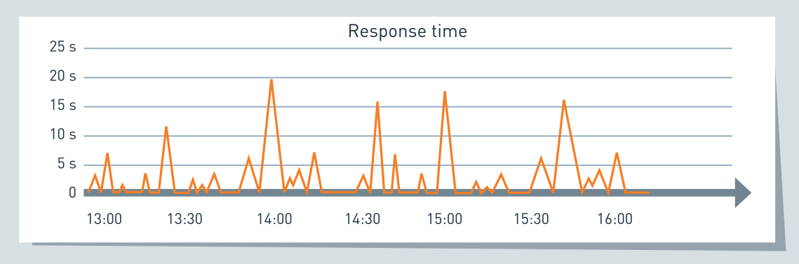
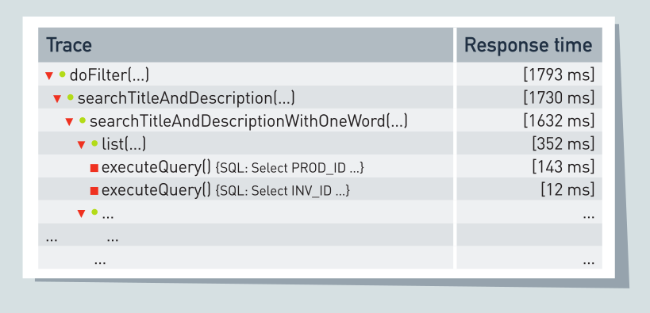
State of the Art of Visualization in APM Tools
Institute of Software Technology Reliable Software Systems
André van Hoorn
Dušan Okanović
Tutorial @ Visualizing Systems and Software Performance (VSSP)
July 10, 2018. Dagstuhl, Germany

Slide 2
Agenda
15 min intro [AvH]
25 min visualizations [DO]
5 min conclusion [AvH+DO]
15 min discussion

Slide 3
State of the Art of Visualization in APM Tools Part 1/2: Introduction to APM
Institute of Software Technology Reliable Software Systems
André van Hoorn
Dušan Okanović
Tutorial @ Visualizing Systems and Software Performance (VSSP)
July 10, 2018. Dagstuhl, Germany

Slide 4
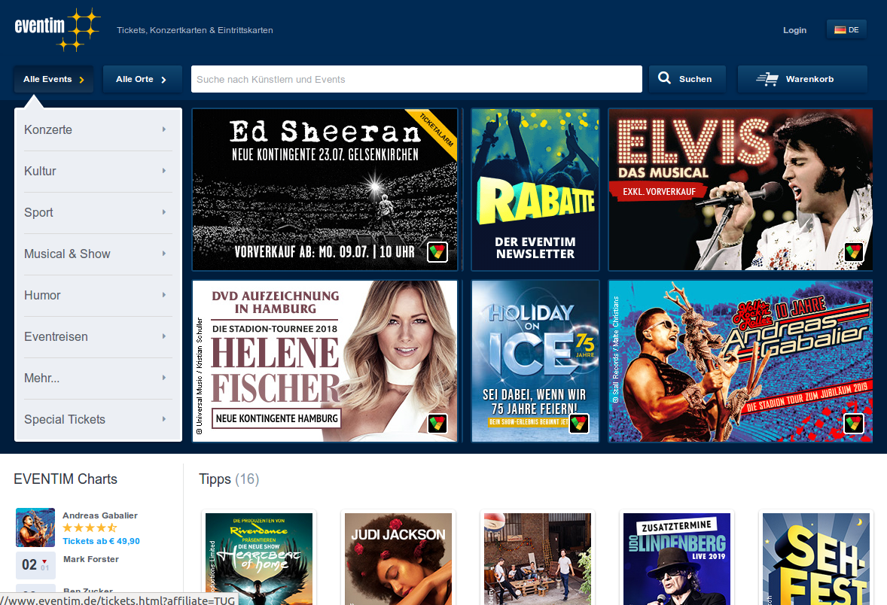
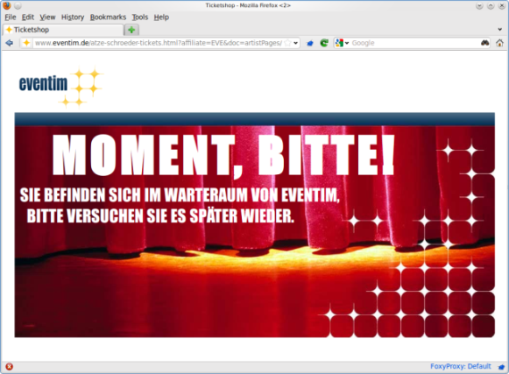

Slide 5
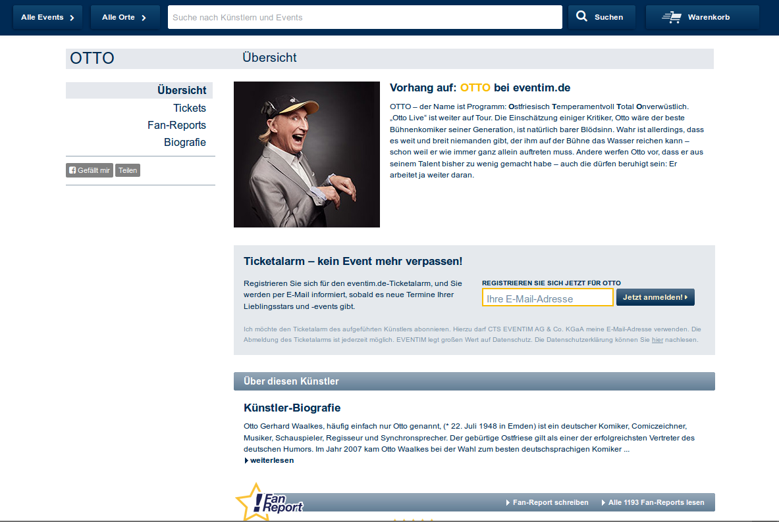

Slide 7
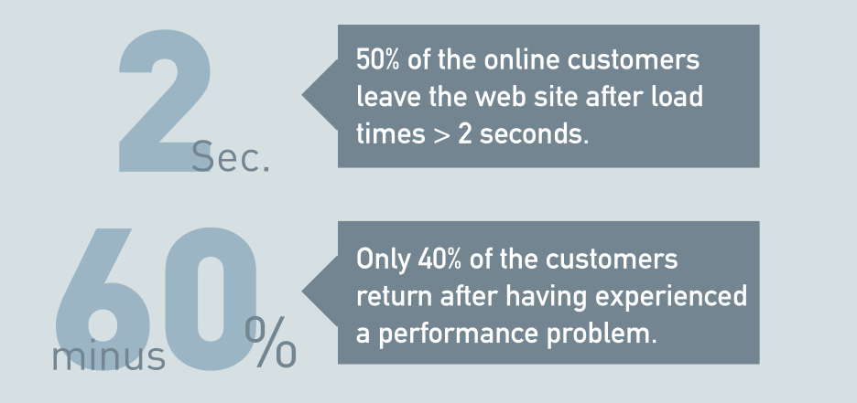
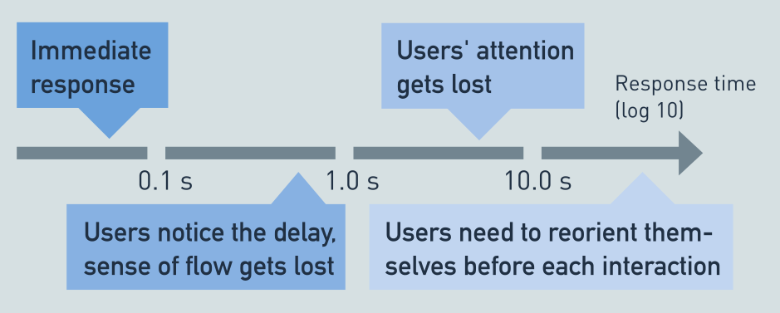
Influence of Poor Performance on the Success of Businesses
Notes:
Anwendungsperformance hat direkten Einfluss auf den Unternehmenserfolg
z.B. Wahrnehmung, Vertrauen, Umsatz
Konsequenzen schlechter Performance
by Jakob Nielsen
https://www.nngroup.com/articles/powers-of-10-time-scales-in-ux/
https://www.nngroup.com/articles/response-times-3-important-limits/

Slide 9
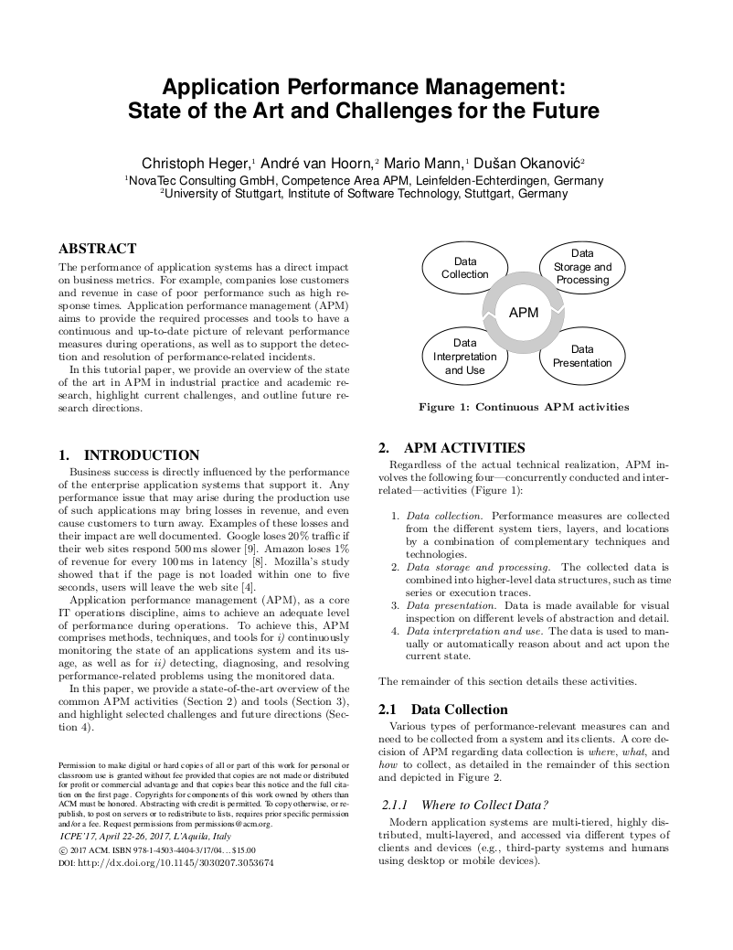
“Application performance management (APM),
as a core IT operations discipline, aims to
achieve an adequate level of performance during operations. To achieve this,
APM comprises methods, techniques, and tools for
continuously monitoring the state of an application system and its usage, as well as for
detecting, diagnosing, and resolving performance-related problems using the monitored data.”
C. Heger, A. van Hoorn, D. Okanović, M. Mann:
Application performance management: State of the art and challenges for the future.
In: Proc. 8th ACM/SPEC ICPE, ACM (2017)

Slide 10
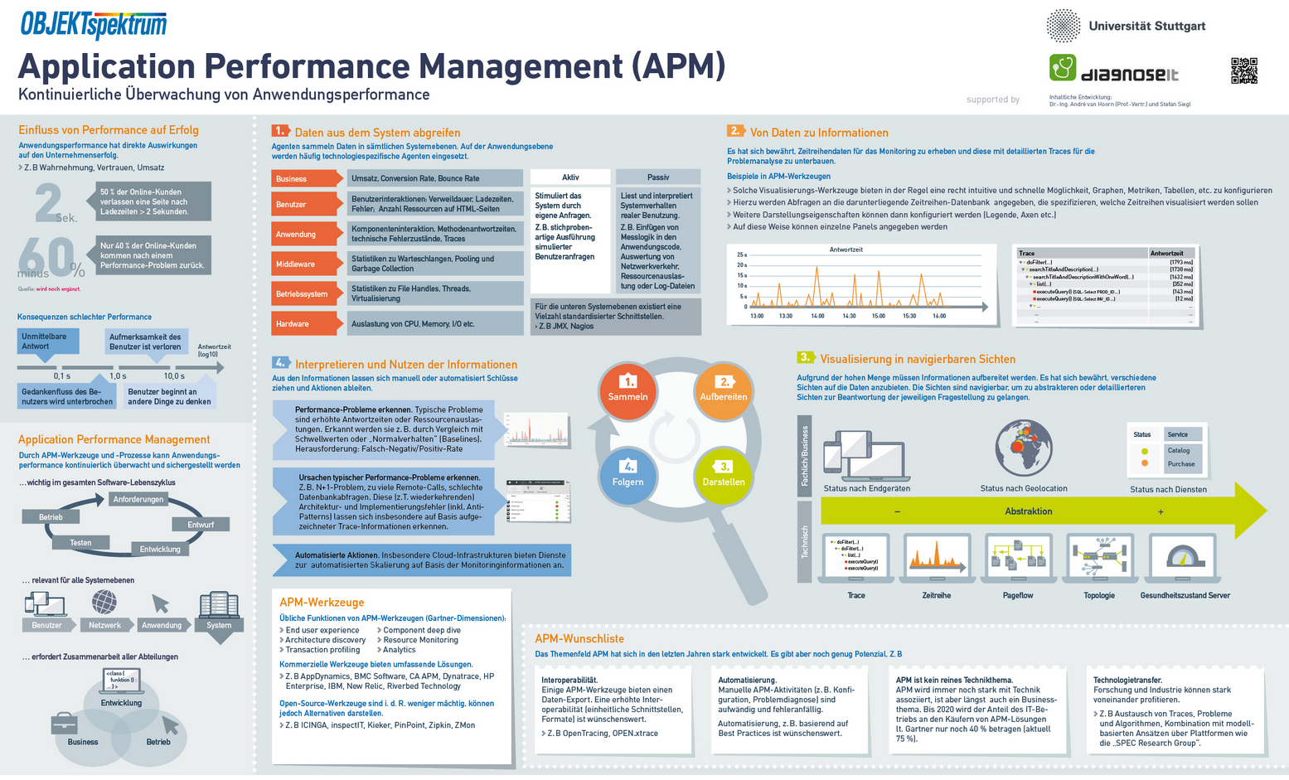
André van Hoorn und Stefan Siegl.
Application Performance Management (APM). Continuous Monitoring of Application Performance. (in German)
Order for free: http://www.sigs-datacom.de/wissen/fachposter.html
Notes:
© Objektspektrum, Fachposter zu Application Performance Management (APM) – Kontinuierliche Überwachung von Anwendungsperformance. Ideengeber André van Hoorn und Stefan Siegl (erscheint)

Slide 11
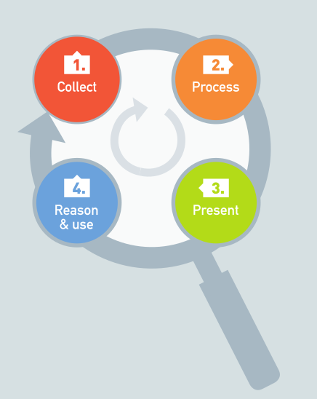
Notes:
© Objektspektrum, Fachposter zu Application Performance Management (APM) – Kontinuierliche Überwachung von Anwendungsperformance. Ideengeber André van Hoorn und Stefan Siegl (erscheint)

Slide 12
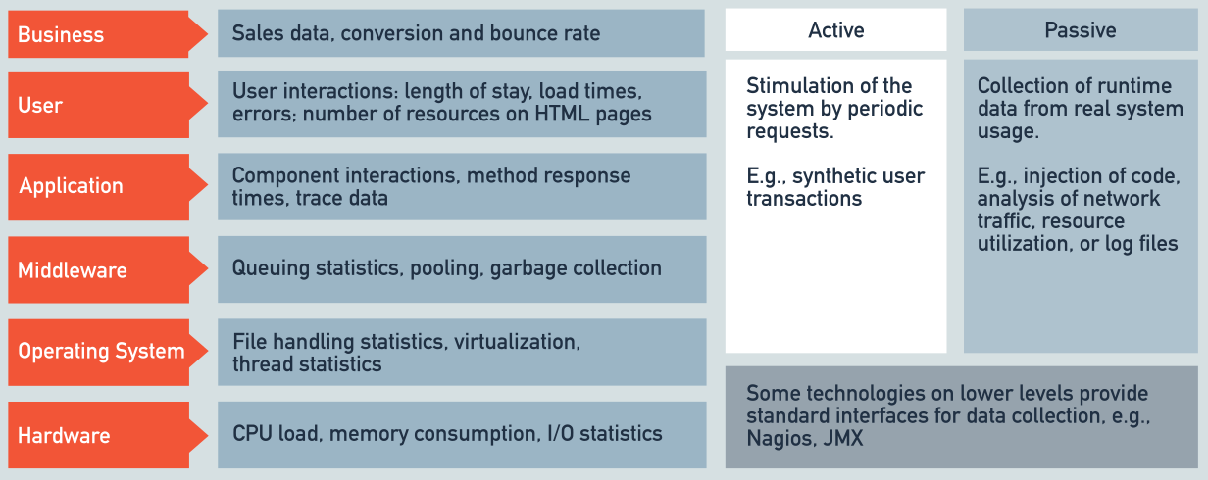
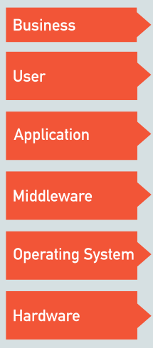
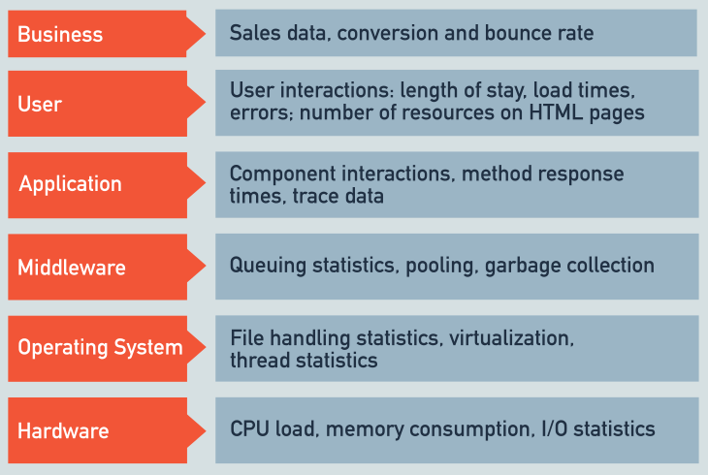
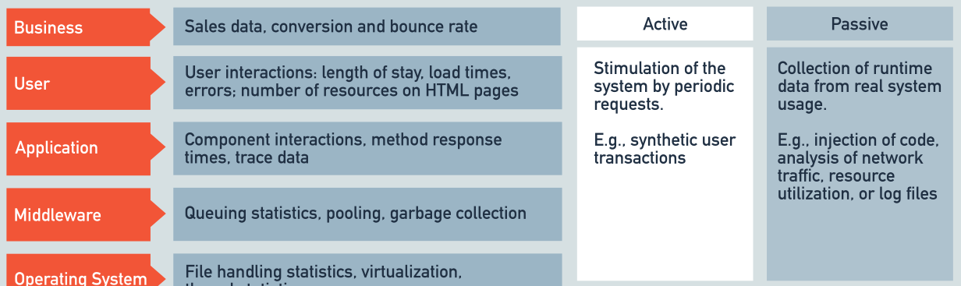
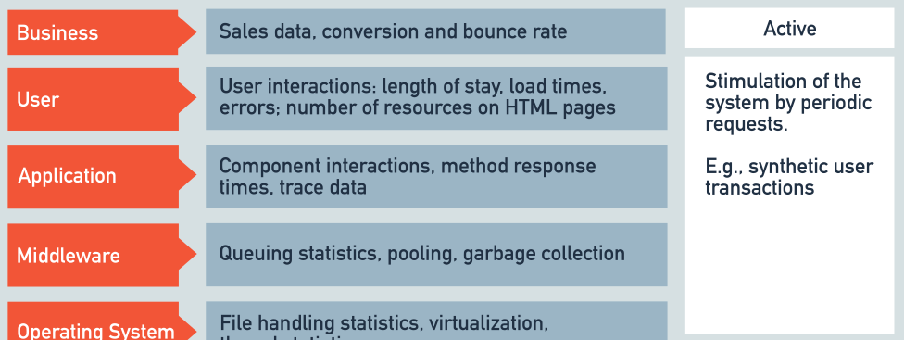
Collecting Data from All System Levels
1.
Agents collect data from all system levels
On application level the agents are often technology-dependent
Where?
What?
How?
Notes:
© Objektspektrum, Fachposter zu Application Performance Management (APM) – Kontinuierliche Überwachung von Anwendungsperformance. Ideengeber André van Hoorn und Stefan Siegl (erscheint)

Slide 13

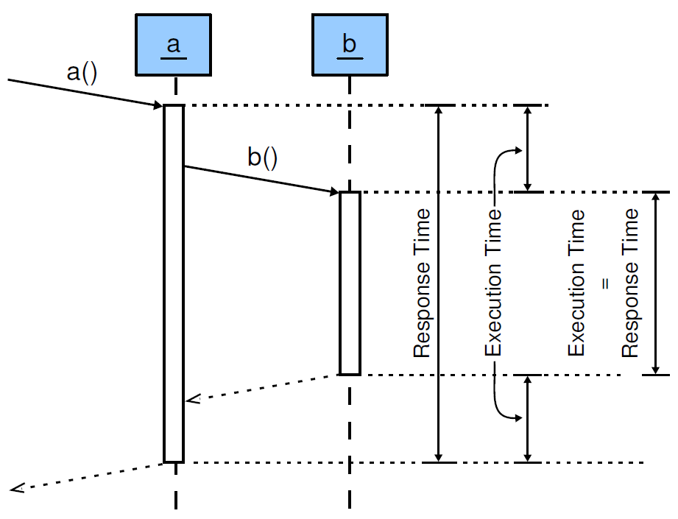
Trace-based Metrics (Selection)
What?
Metric
Response Time
CPU Time
Method Name
Return Type
Logging Level
SQL Statement
Error Message
…
Okanović, D., van Hoorn, A., Heger, C., Wert, A., Siegl, S.:
Towards performance tooling interoperability: An open format for representing execution traces.
In: Proc. EPEW ’16. LNCS, Springer (2016)

Slide 14
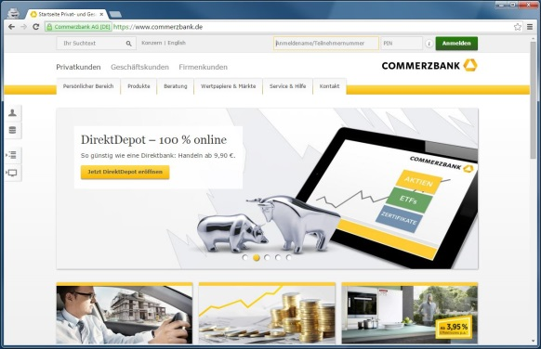
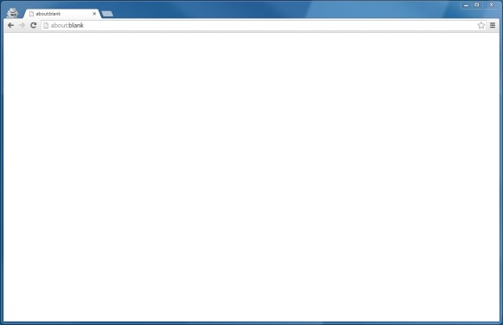
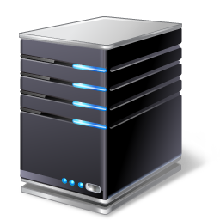
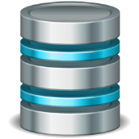
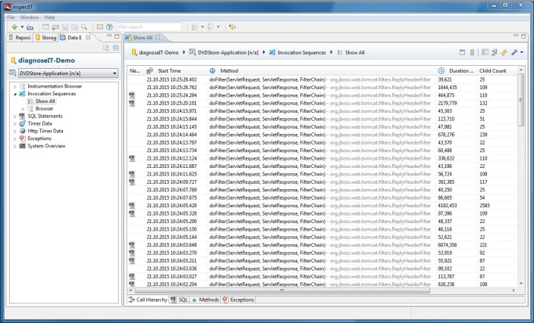
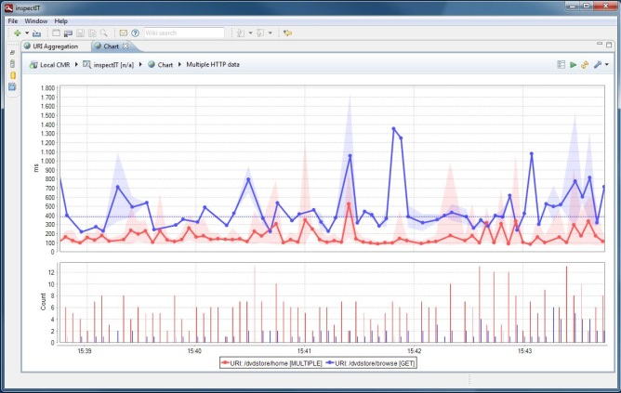
Monitoring (Measurement-based Performance Evaluation)
0.3s
0.2s
0.3s
0.1s
3.0s
3.0s
Request
Query
(fictional timings)
Response
0.5s
Result
Client Browser
0.4s
Application Server
0.1s
Database Server
4.9s
Data Analysis
Visualization
Data Recorder

Slide 15
Reconstructing Information from Data
2.
Data is collected from the system…
represented as time series…
Notes:
© Objektspektrum, Fachposter zu Application Performance Management (APM) – Kontinuierliche Überwachung von Anwendungsperformance. Ideengeber André van Hoorn und Stefan Siegl (erscheint)

Slide 16
Reconstructing Information from Data
2.
Data is collected from the system…
represented as time series…
… and as detailed execution traces, and used to support problem analysis
Notes:
© Objektspektrum, Fachposter zu Application Performance Management (APM) – Kontinuierliche Überwachung von Anwendungsperformance. Ideengeber André van Hoorn und Stefan Siegl (erscheint)

Slide 17
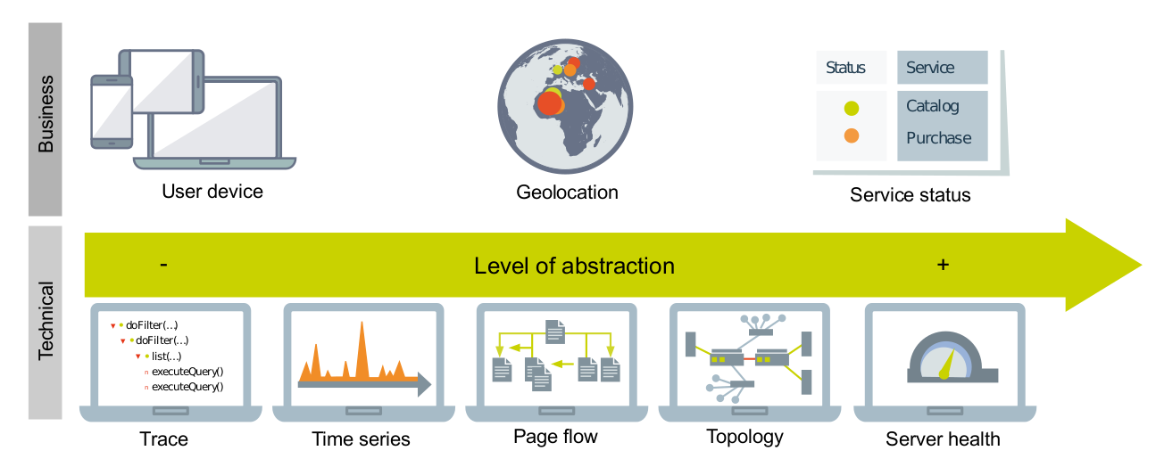
Visualization Through Navigable Views
3.
High quantity of information has to be pre-processed
It has proven useful to use different views to show the data
Views are navigable and can be categorized by both scope and detail level
Notes:
© Objektspektrum, Fachposter zu Application Performance Management (APM) – Kontinuierliche Überwachung von Anwendungsperformance. Ideengeber André van Hoorn und Stefan Siegl (erscheint)

Slide 18
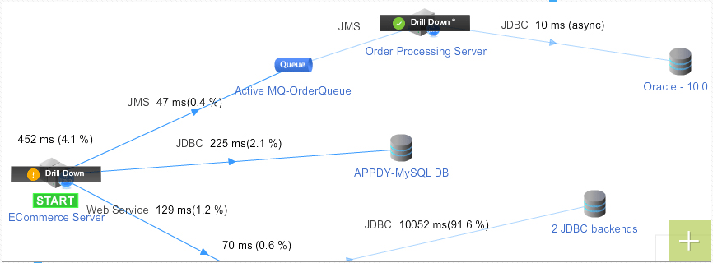
Example: Application Topology Discovery and Visualization
© AppDynamics
Notes:
Instana, serverless-Architekturen

Slide 19
Interpreting and Using the Information
4.
Manual or automated conclusions and actions can be derived from the information, e.g.,
Problem detection and alerting
E.g., increased response times and resource utilization
Detection, for instance, based on thresholds and baselines
Problem diagnosis and root cause isolation
E.g., N+1 problem, too many remote calls, poor DB queries
Detection based on monitoring information
System refactoring and adaptation
E.g., auto-scaling in cloud-based architectures
Notes:
© Objektspektrum, Fachposter zu Application Performance Management (APM) – Kontinuierliche Überwachung von Anwendungsperformance. Ideengeber André van Hoorn und Stefan Siegl (erscheint)

Slide 20
State of the Art of Visualization in APM Tools Part 2/2: Examples Visualizations in APM Tools
Institute of Software Technology Reliable Software Systems
André van Hoorn
Dušan Okanović
Tutorial @ Visualizing Systems and Software Performance (VSSP)
July 10, 2018. Dagstuhl, Germany

Slide 21
Commercial APM Tools
Notes:
The most obvious one.
Reducing the required effort of APM

Slide 22
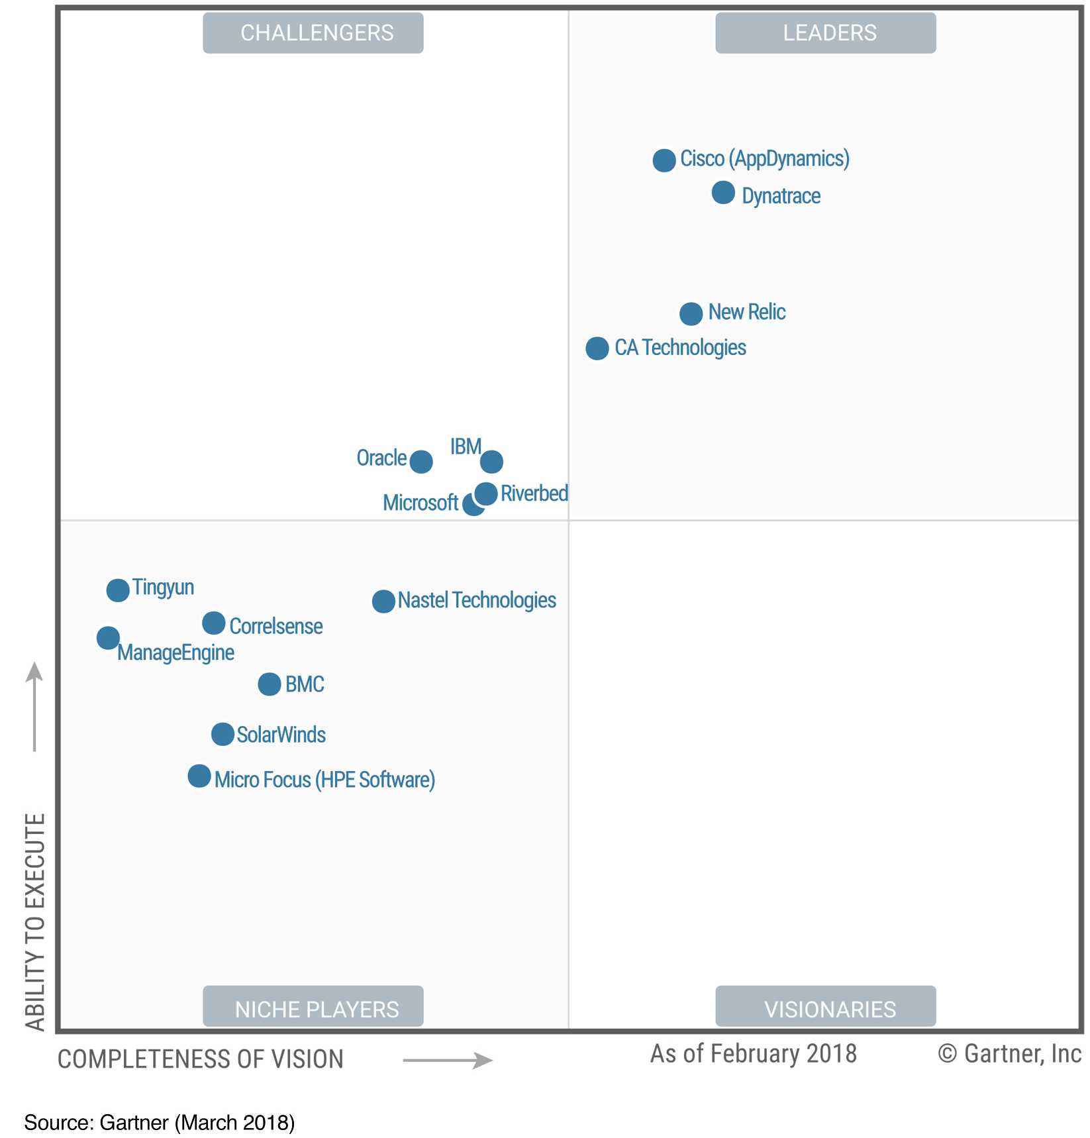
Magic Quadrant

Slide 23
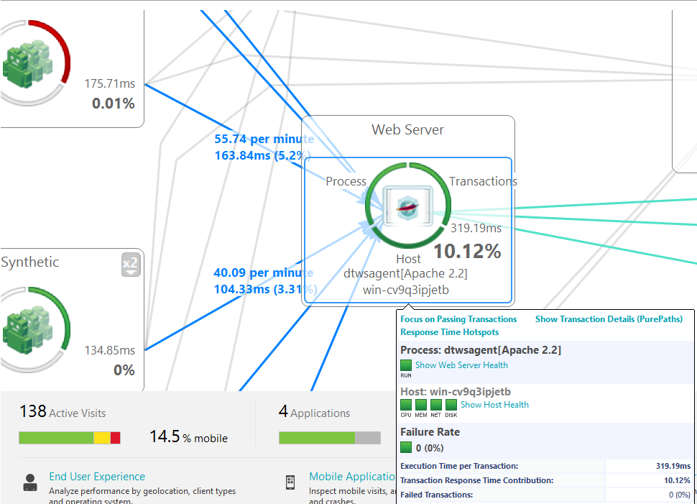
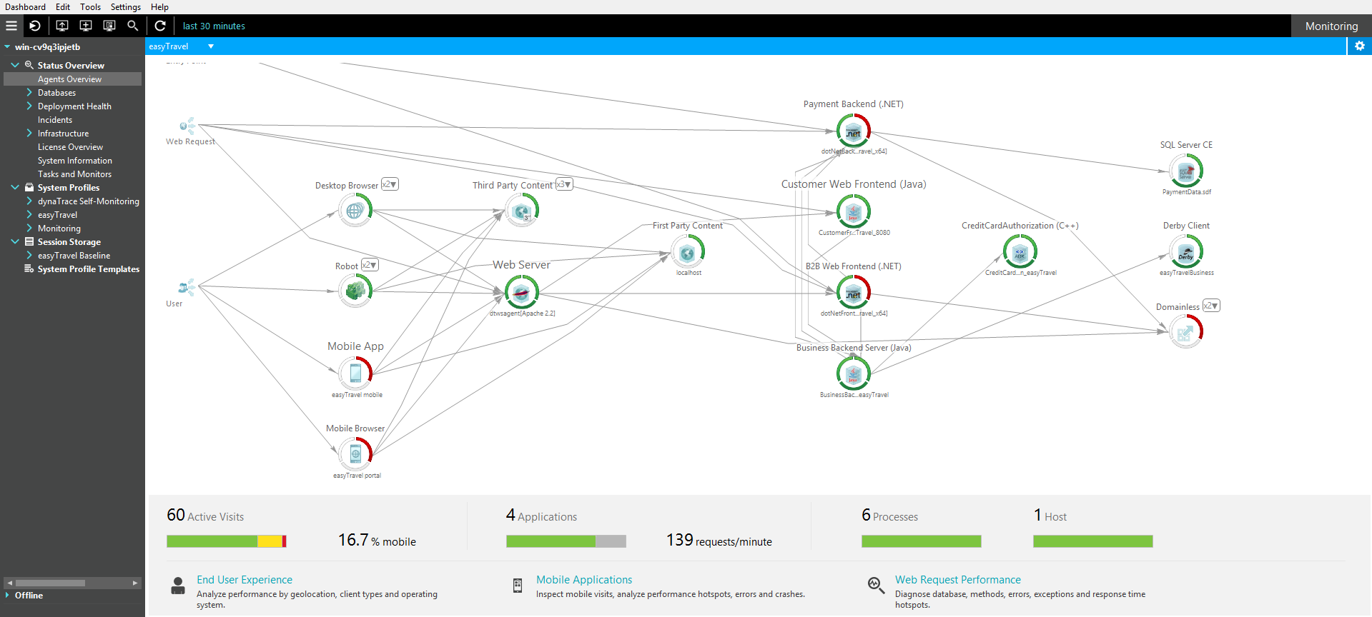
Application Overview – Dynatrace

Slide 24
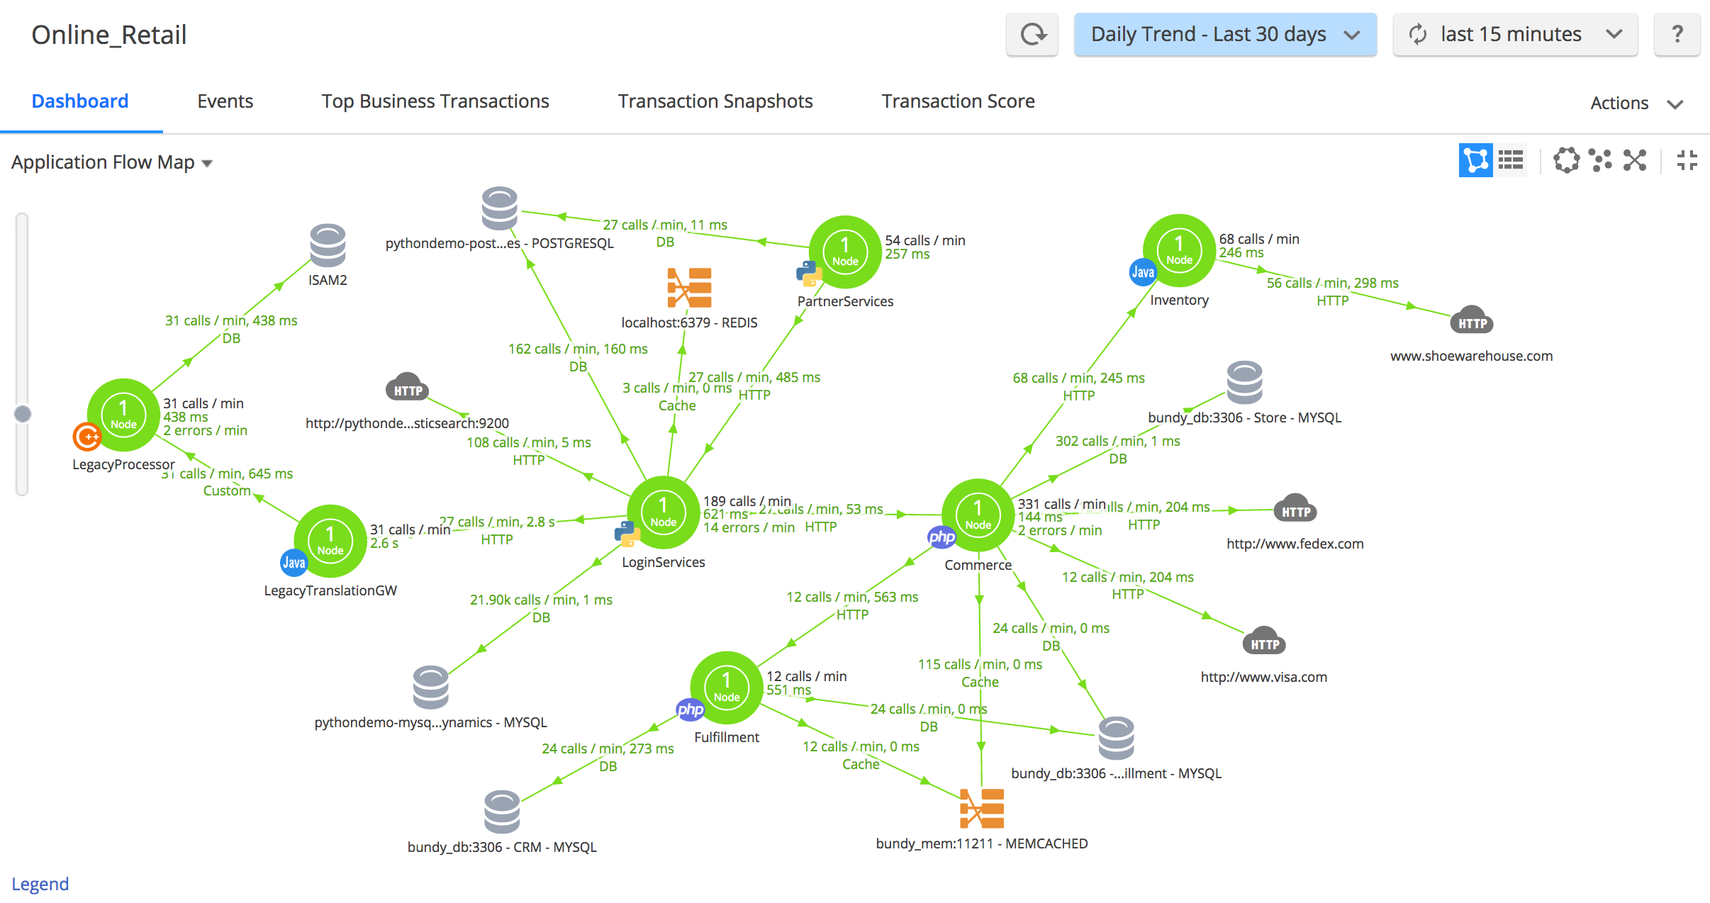
Application Overview – AppDynamics

Slide 25
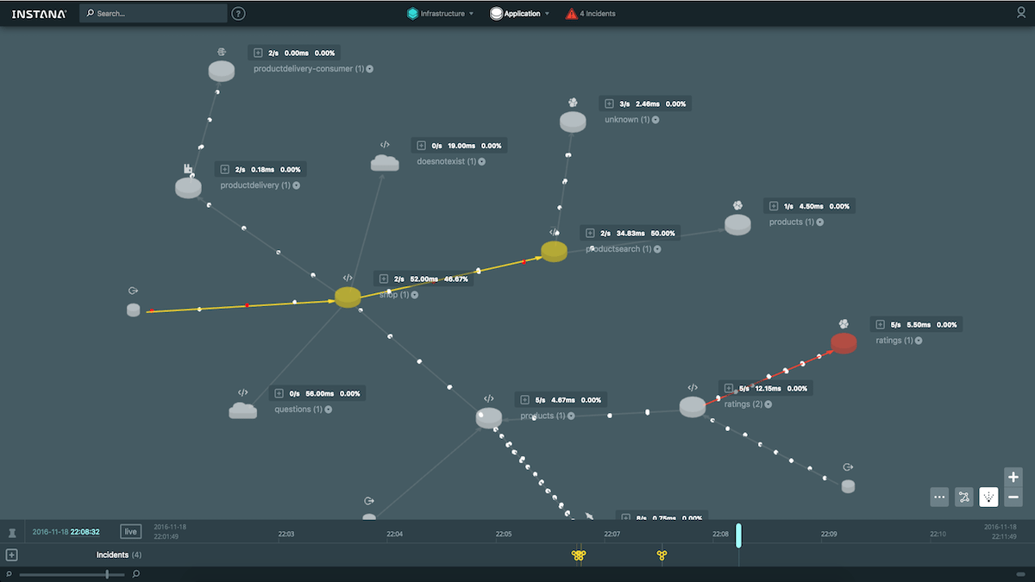
Application Overview – Instana

Slide 26
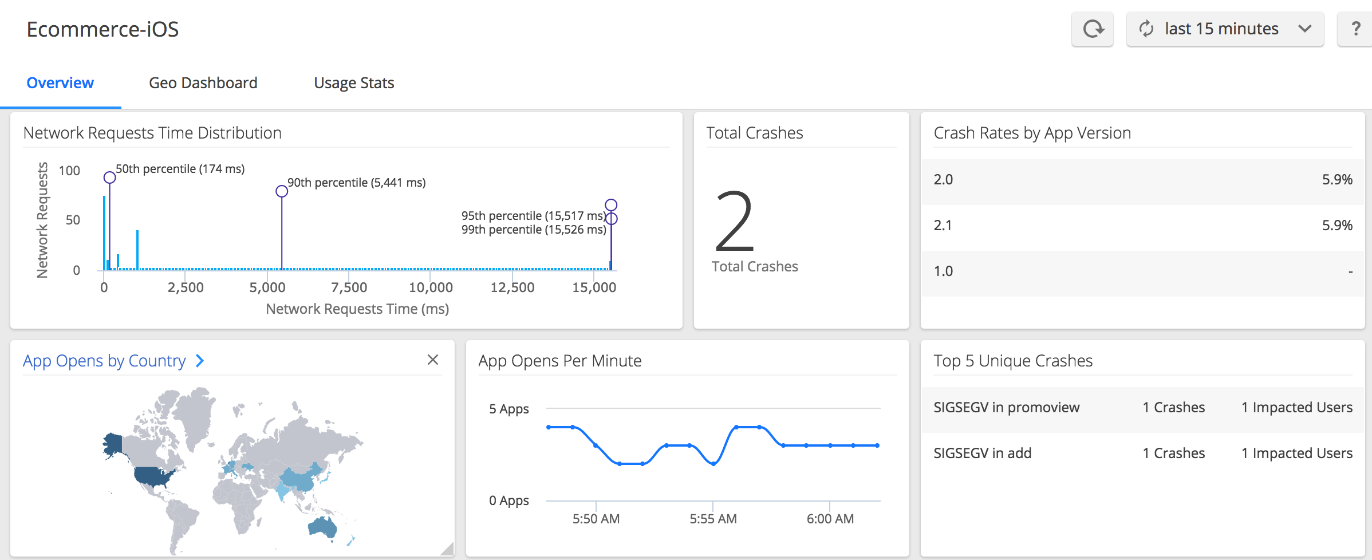
End User Monitoring – AppDynamics

Slide 27
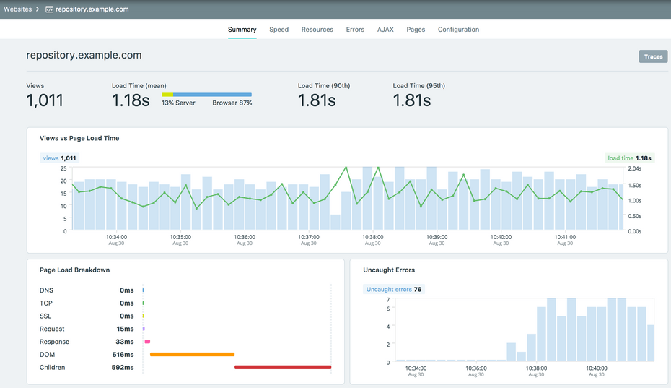
End User Monitoring– Instana

Slide 28
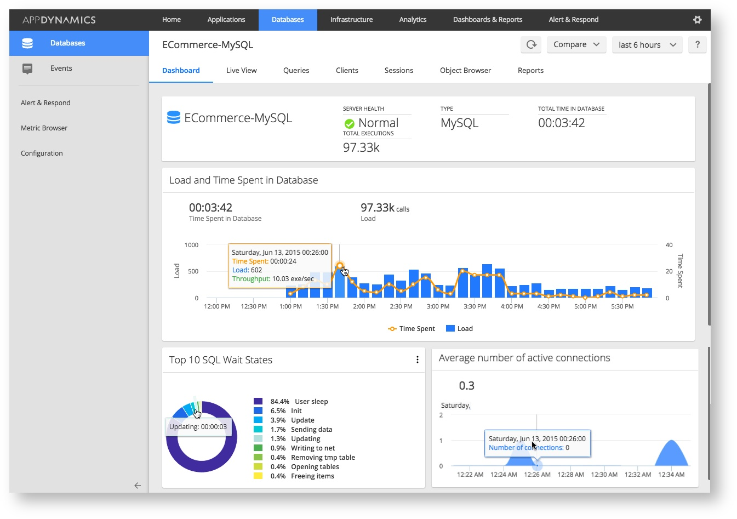
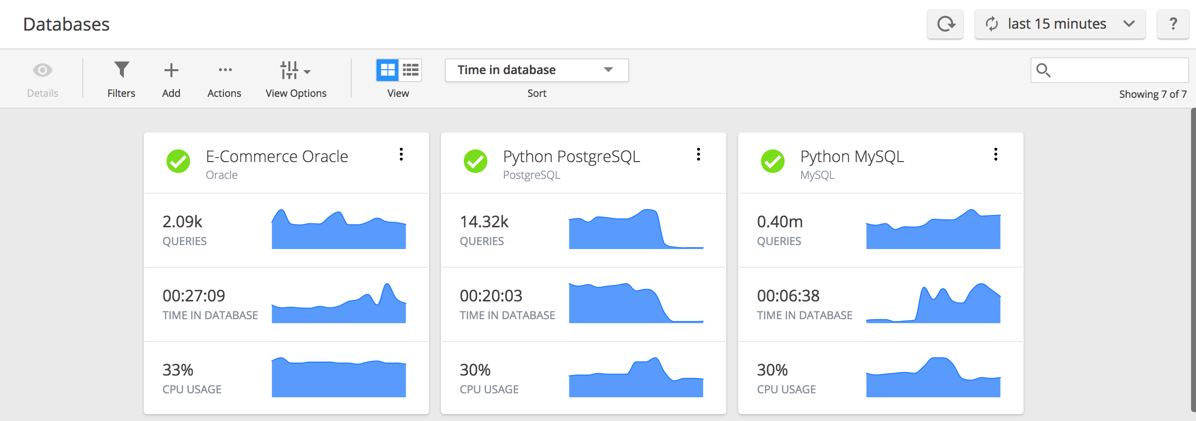
Database Monitoring – AppDynamics

Slide 29
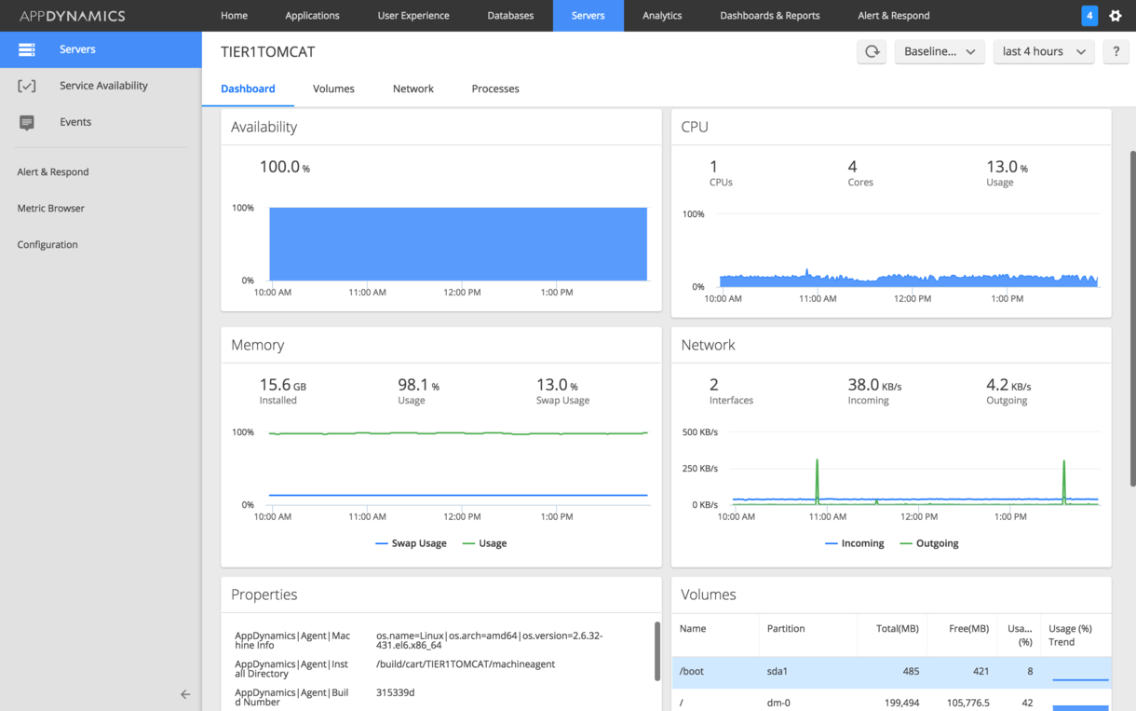
Server Monitoring – AppDynamics

Slide 30
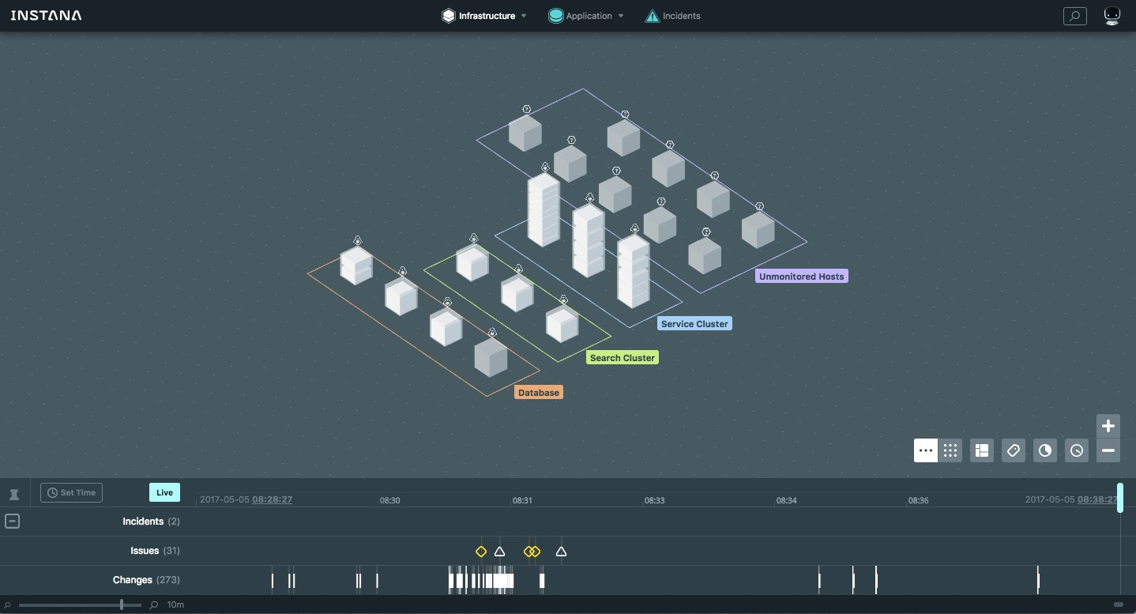
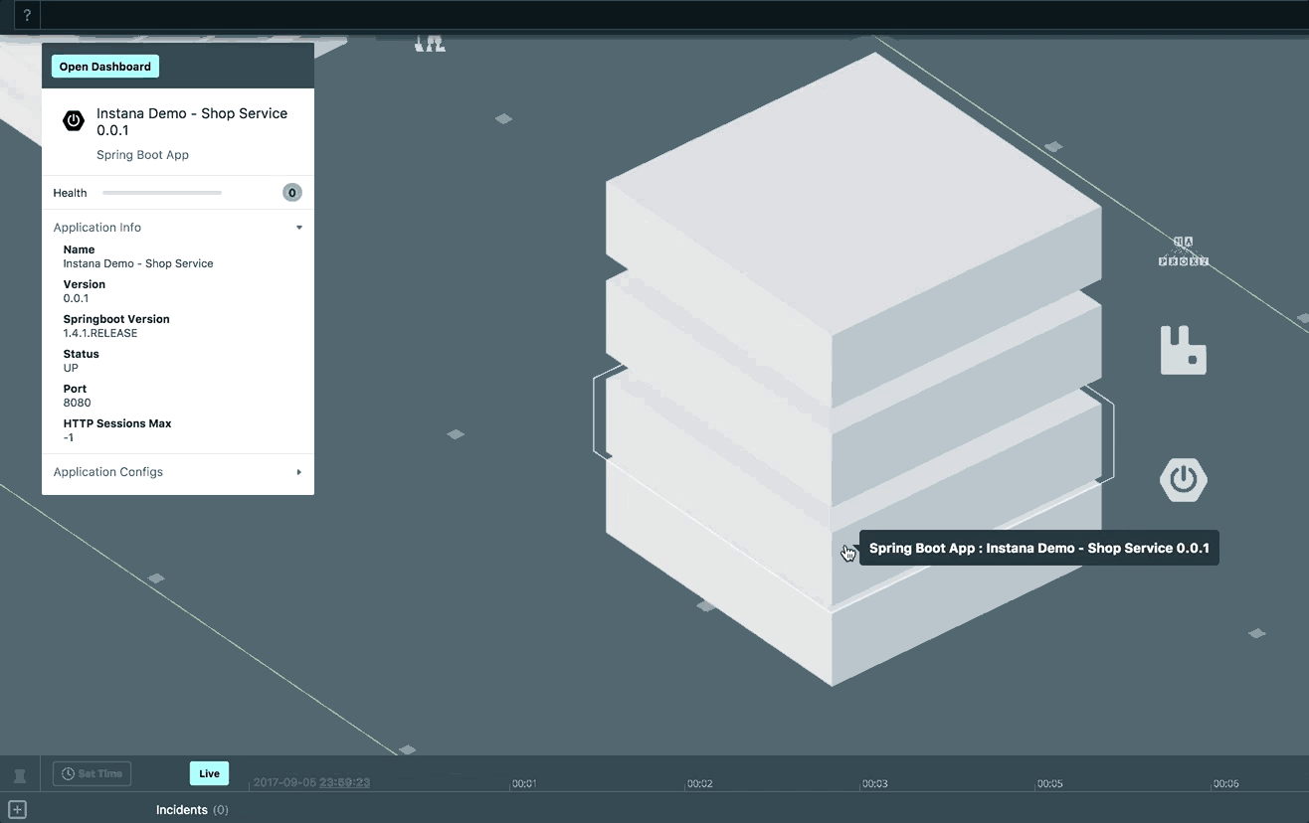
Server Monitoring – Instana

Slide 31
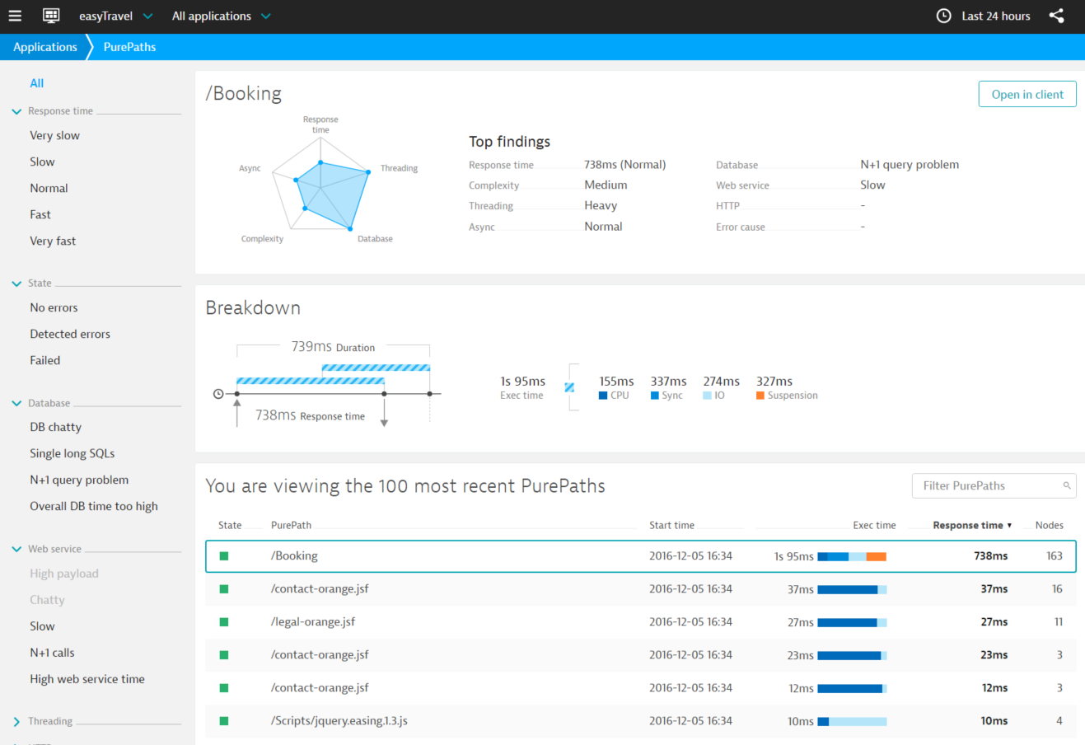
Problem Identification – Dynatrace

Slide 32
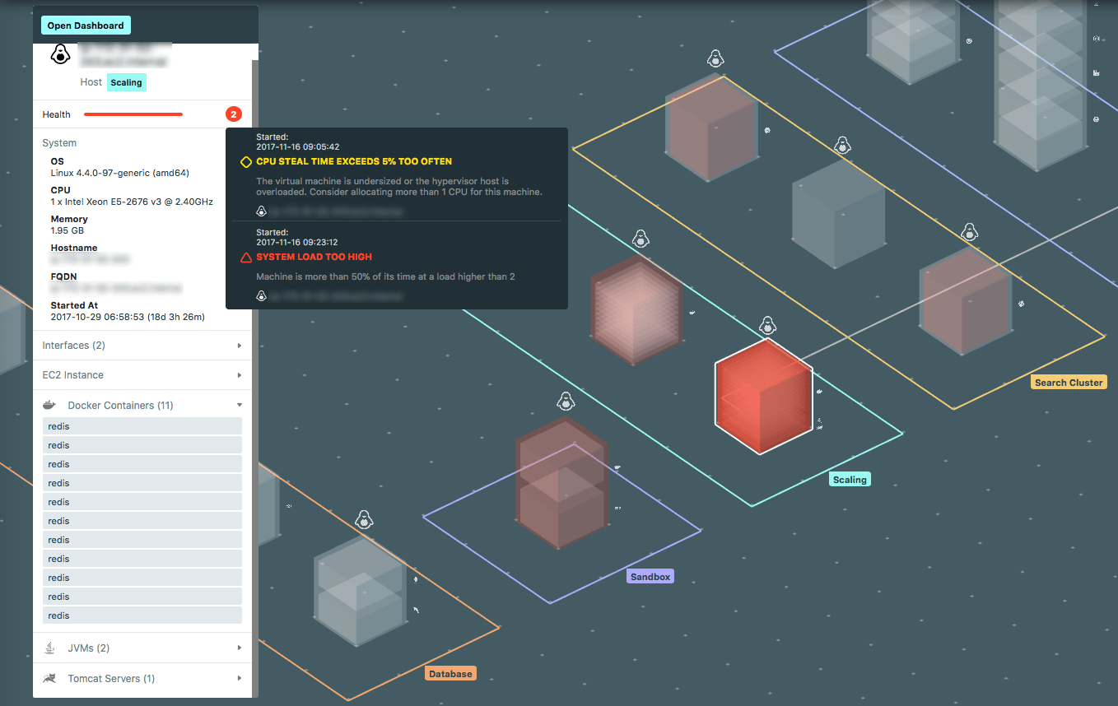
Problem Identification - Instana

Slide 33
Open Source APM tools

Slide 34
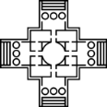








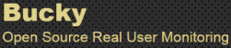
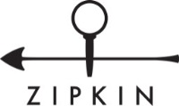


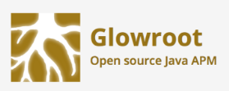

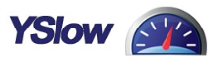
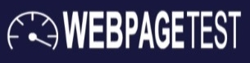




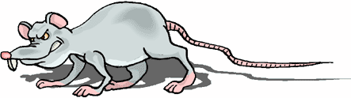

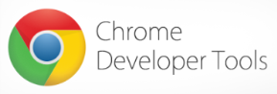



Open Source APM tools
Monitoring & Application Deep Dive
Performance Modeling
Real User Monitoring
Web Performance Analysis
System & Resources Monitoring
Low-Level Performance Profiling
JRat
JMemProf

Slide 35
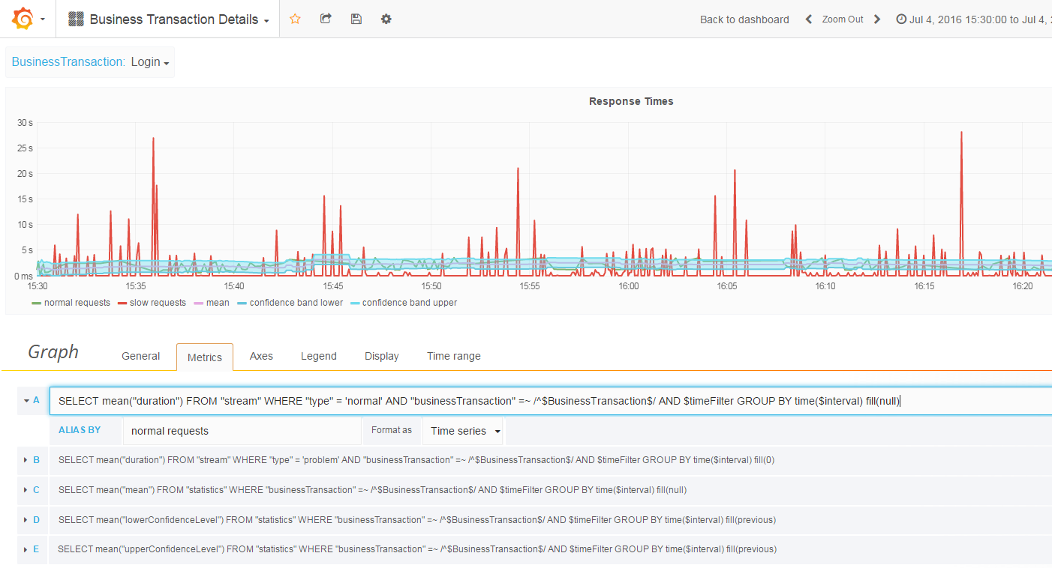
Dashboards – Grafana

Slide 36
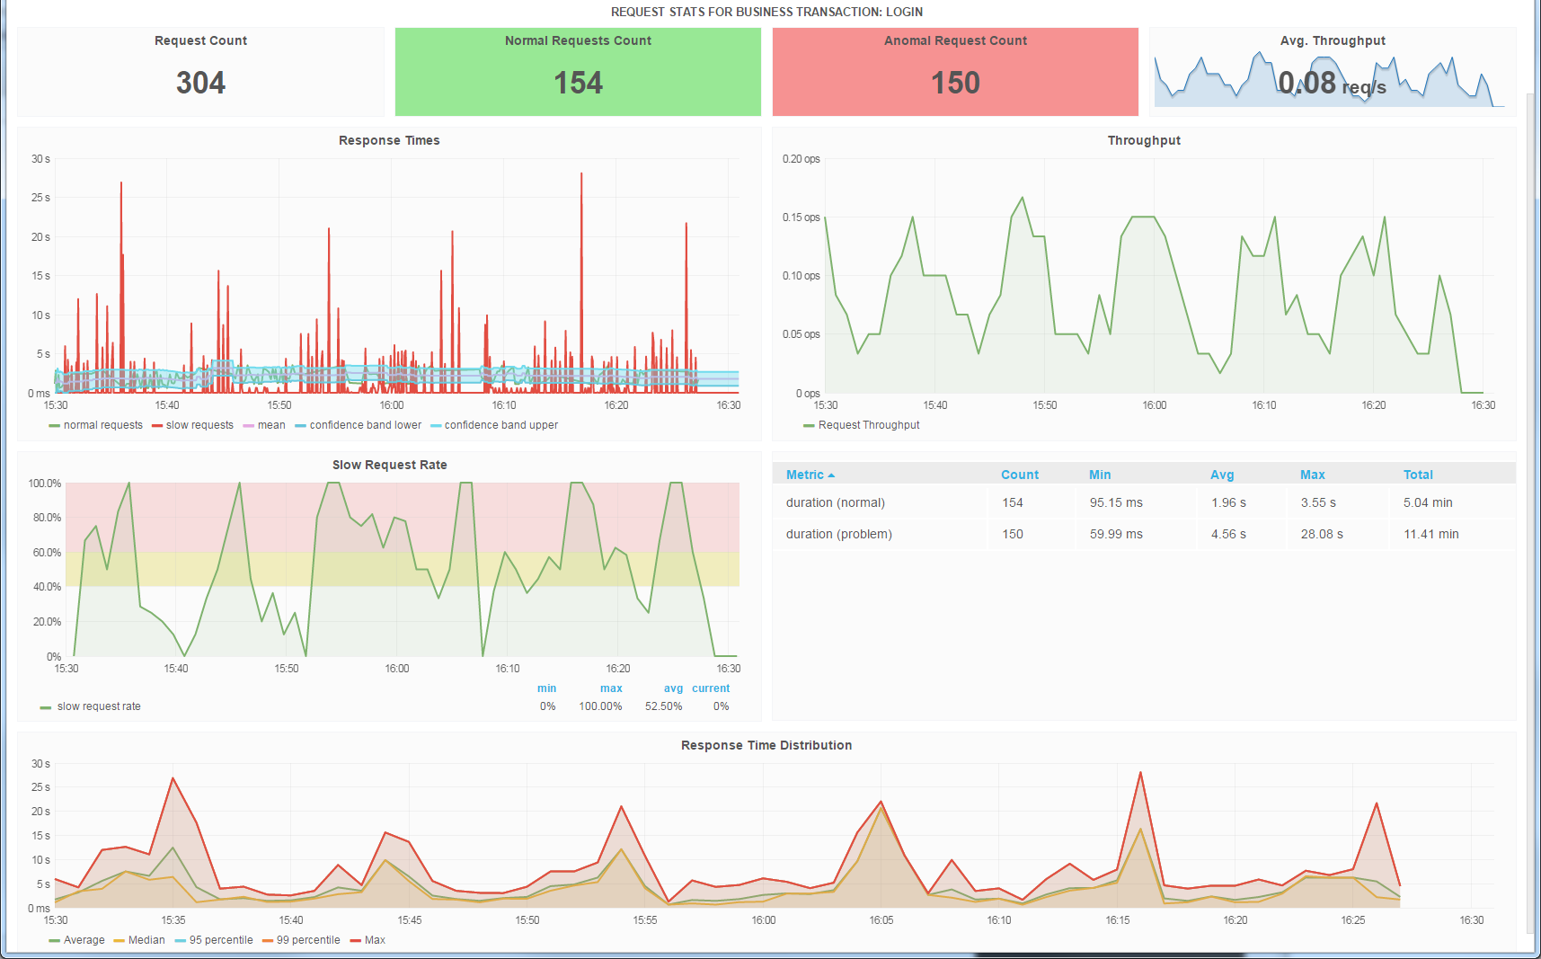
Dashboards – Grafana

Slide 37
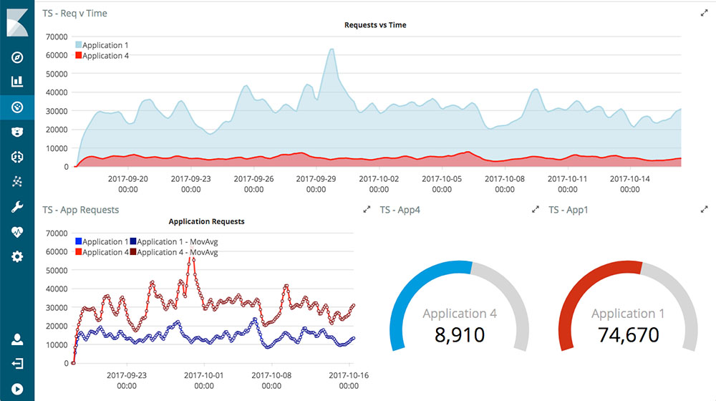
Dashboards – Kibana

Slide 38

Dashboards – Kibana

Slide 39

Execution Traces – inspectIT
OPEN.xtrace
https://github.com/spec-rgdevops/OPEN.xtrace

Slide 40

Tracing – Zipkin

Slide 41



Build Your Own Landscape
https://openapm.io

Slide 42








Dynamic Software Analysis and Application Performance Management
http://kieker-monitoring.net

Slide 43




Application (and Visualization) Examples
Legacy System Analysis
(Visual Basic 6)
Distributed Monitoring (Java EE/SOAP)
Legacy System Analysis
(COBOL)
3D Visualization of Concurrency

Slide 44
Conclusion
Commercial tools have most fancy visulizations
… how useful are they really?
Open-source tools are flexible and can be adapted as needed
… but require a lot of work to setup
Thanks to a more widespread adoption of (open-source) APM, it is easier to get access to rich APM data (e.g., distributed traces) and to integrate visualization approaches (e.g., via APIs)
… if you know what and how to visualize

